Slide 1
Chapter 6
More About Program Structure
Initializing Function Parameters
Exceptions
Function Overloading
Eliminating Characters in a String

Slide 2
Initializing Function Parameters
Allows the user to call a function using “default” parameter values.
Any number of arguments in the parameter list may be “defaulted”.
Omitted parameters must be rightmost in the argument list.

Slide 3
Initializing Function Parameters
Example:
void listParameters(int i = 0,
const char* msg = "This is the default msg");
void main()
{
listParameters();
listParameters(5);
listParameters(6,"this is a test");
}
void listParameters(int i, const char* msg)
{
cout << "i = " << i << " msg = " << msg << endl;
}

Slide 4
Initializing Function Parameters
Output:
from listParameters( )
i = 0 msg = This is the default msg
from listParameters( 5 )
  i = 5 msg = This is the default msg
from listParameters( 6,"this is a test“ )
  i = 6 msg = this is a test

Slide 5
Exception Handling
Allow the application to “gracefully” recover from error conditions.
For testing/debugging
  assert() function
    Evaluates an expression
    When false – print diagnostic message and abort
Exception processing
  try
  throw
  catch

Slide 6
Using assert()
Evaluates an expression and when the result is FALSE, prints a diagnostic message and aborts the program.
void assert( int expression );
Requires <assert.h>
Example
  int var1, var2;
  …
  assert (var1 != 0);
  cout << var2/var1 << endl;
  Output:
  Assertion failed: var1 != 0, file …, line …

Slide 7
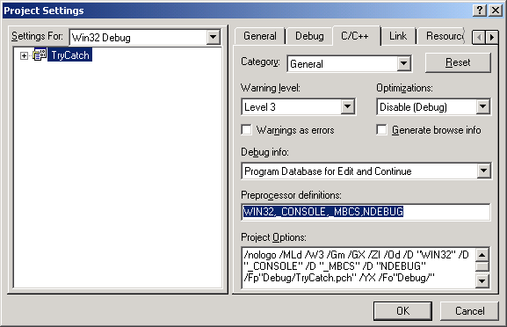
Using assert()
Can be turned off without modifying the source file by defining the identifier NDEBUG in Project Settings

Slide 8
Throwing Exceptions
try
{
statement block
...
if (some error condition)
// throws an exception of a known type
throw(errorType);
int var1 = 0,
var2;
var2 = 123/var1; // this causes an exception
...
}

Slide 9
Catching Exceptions
catch(errorType)
{
// this “catches” an exception of a // specific type
what to do...
}
catch(...)
{
//this is the default catch
...
}

Slide 10
Exception Processing Example
try
{
cout << "This is inside the try" << endl;
throw ("This is a const char* error");
cout << "This is after the throw()" << endl;
}
catch(const char* errMsg)
{
cout << "ERROR: " << errMsg << endl;
}
cout << "This is outside the try block" << endl;
Output:
This is inside the try
ERROR: This is a const char* error
This is outside the try block

Slide 11
Exception Processing
“default” catch
try
{
int var1 = 0;
cout << 5/var1 << endl;
}
catch(const char* errMsg)
{
cout << "ERROR: " << errMsg << endl;
}
catch(...) // must be the last catch
{
cout << "Unknown error caught" << endl;
}

Slide 12
Bad allocation exception
(when new fails)
#include <new>
using std::bad_alloc;
try
{
double *temp[50];
for (int i = 0; i < 50; i++)
{
temp[i] = new double[500000];
cout << "Allocated 500000 doubles in temp[ " << i
<< "]" << endl;
}
}
catch (bad_alloc exception)
{
cout << "Exception occurred in new ..." <<
exception.what() << endl;
}

Slide 13
Function Overloading
Allows the same function name to be used with different parameter types.
Example
  Return the maximum value in an array:
  int max(int* array, int len); //Array of int
  long max(long* array, int len); // Array of long
  double max(double* array, int len); // Array of double
Note: remember that functions must vary in parameter list for the compiler to distinguish one from the other.

Slide 14
Function Overloading Example
int max(int* array, int len);
long max(long* array, int len);
double max(double* array, int len);
void main()
{
int iArray[] = {11,21,31,41,51,61,71,81,91};
long lArray[] = {19,18,17,16,15,14,13,12,11};
double dArray[] = {1.0, 3.0, 5.0, 7.0, 9.0, 2.0, 4.0, 6.0, 8.0};
cout << "max value of iArray is "
<< max( iArray, sizeof(iArray)/sizeof(int) ) << endl;
cout << "max value of lArray is "
<< max( lArray, sizeof(lArray)/sizeof(long) ) << endl;
cout << "max value of dArray is "
<< max( dArray, sizeof(dArray)/sizeof(double) ) << endl;
}

Slide 15
Function Overloading Example
int max(int* array, int len)
{
int max = array[0];
for (int i = 1; i < len; i++)
max = max > array[i]? max:array[i];
return max;
}
long max(long* array, int len)
{
long max = array[0];
for (int i = 1; i < len; i++)
max = max > array[i]? max:array[i];
return max;
}
double max(double* array, int len)
{
double max = array[0];
for (int i = 1; i < len; i++)
max = max > array[i]? max:array[i];
return max;
}

Slide 16
Eliminating Characters in a String
Write a form of strcpy() that uses the same string for destination and source.
The contents of the string are overwritten by itself.
Two pointers are used to traverse the string.
  Pointer “char *d” can be used for the destination
  Pinter “char *s” can be used for the source

Slide 17
Eliminating Characters in a String (example)
...
char source[] = "Now is the time for all ";
cout << eatspaces(source) << endl;
...
char* eatspaces(char* source)
{
char *d = source,
*s = source;
while ((*d++ = *s++) != '\0')
if (*s == ' ')
s++;
return source;
}
Output:
Nowisthetimeforall

